Slide 1
PROGETTO LINGUA INGLESE
Scuola dell’Infanzia
Plesso Madonna della Catena
Gagliardi Maria

Slide 2
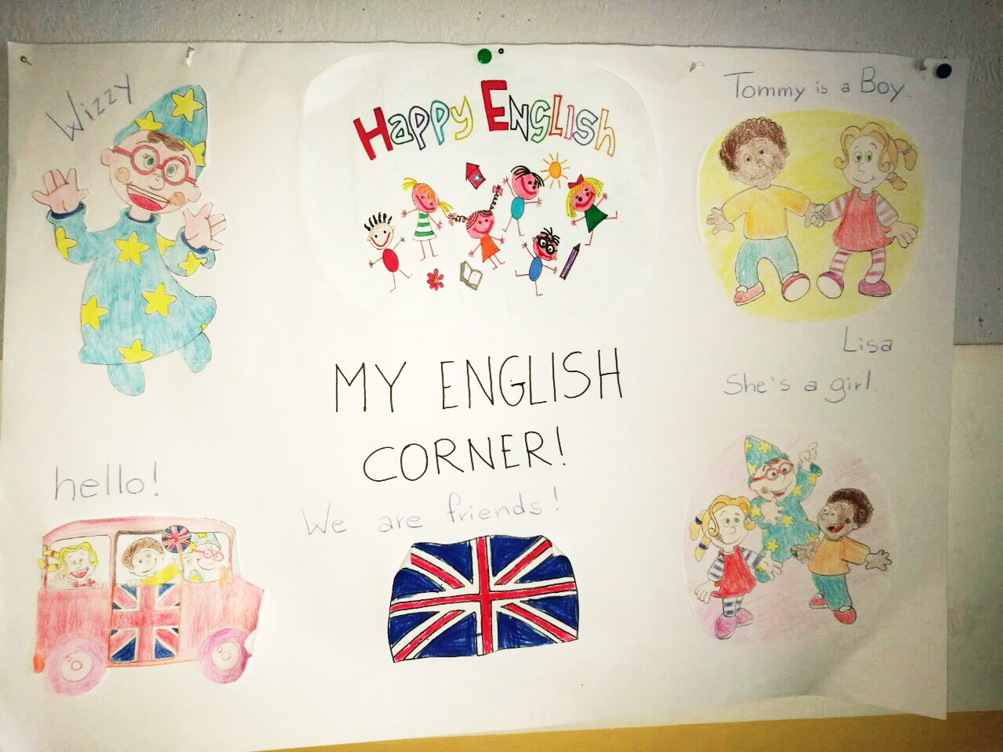

Slide 3
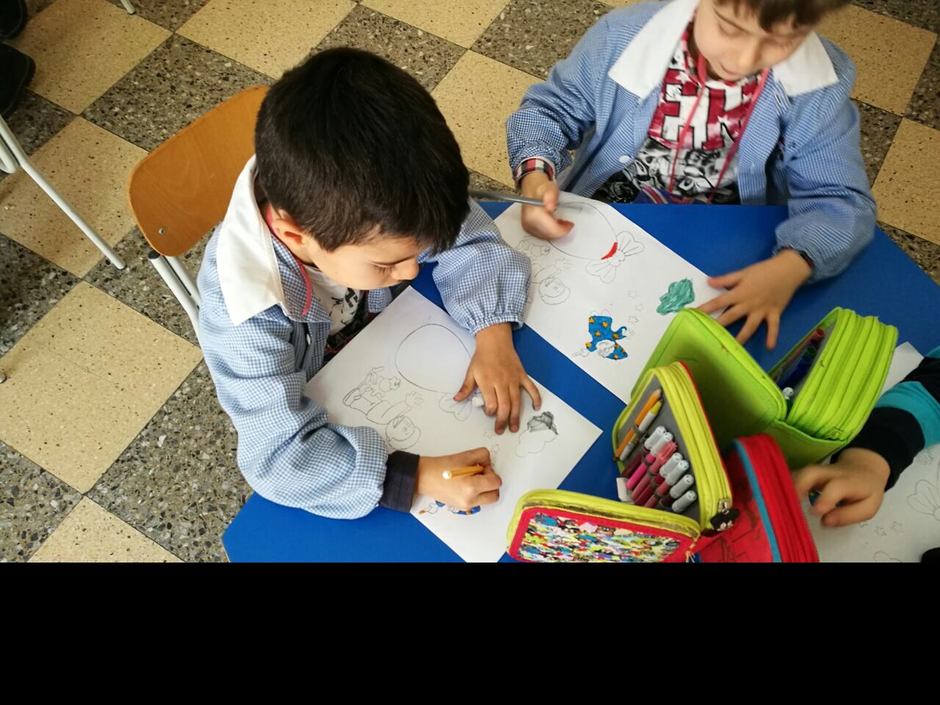
PLAY AND LEARN…………TOGETHER

Slide 4
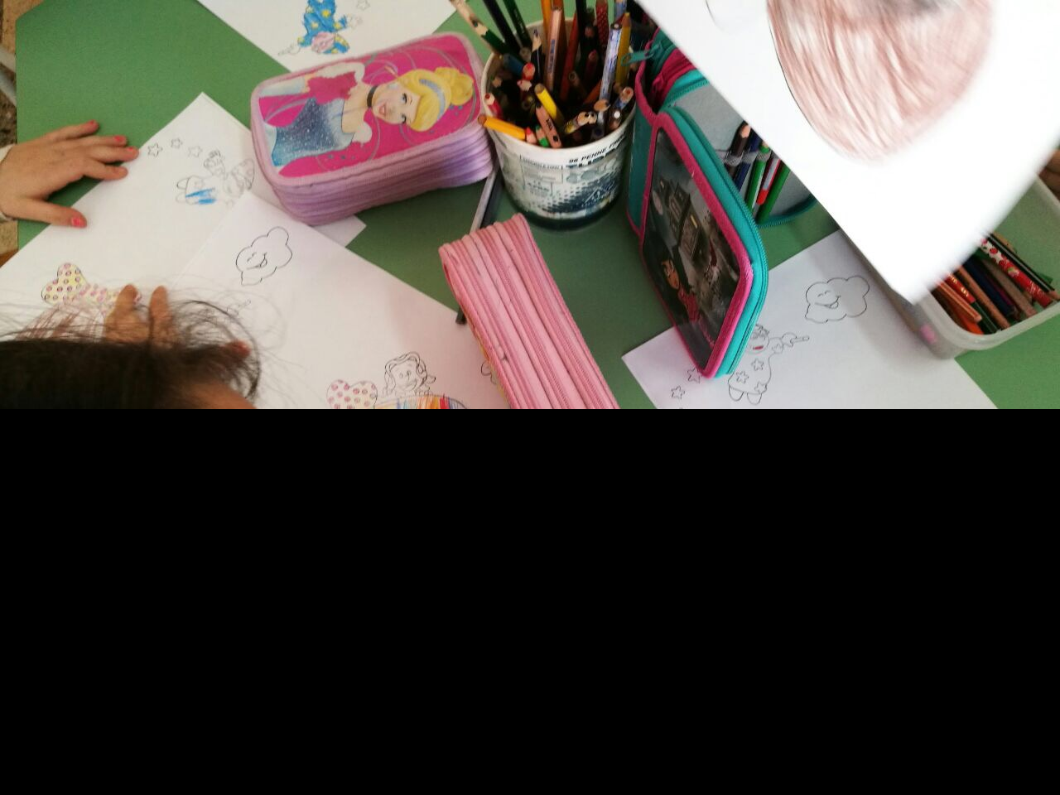
…..HAPPY EASTER! WITH TOMMY AND LISA

Slide 5
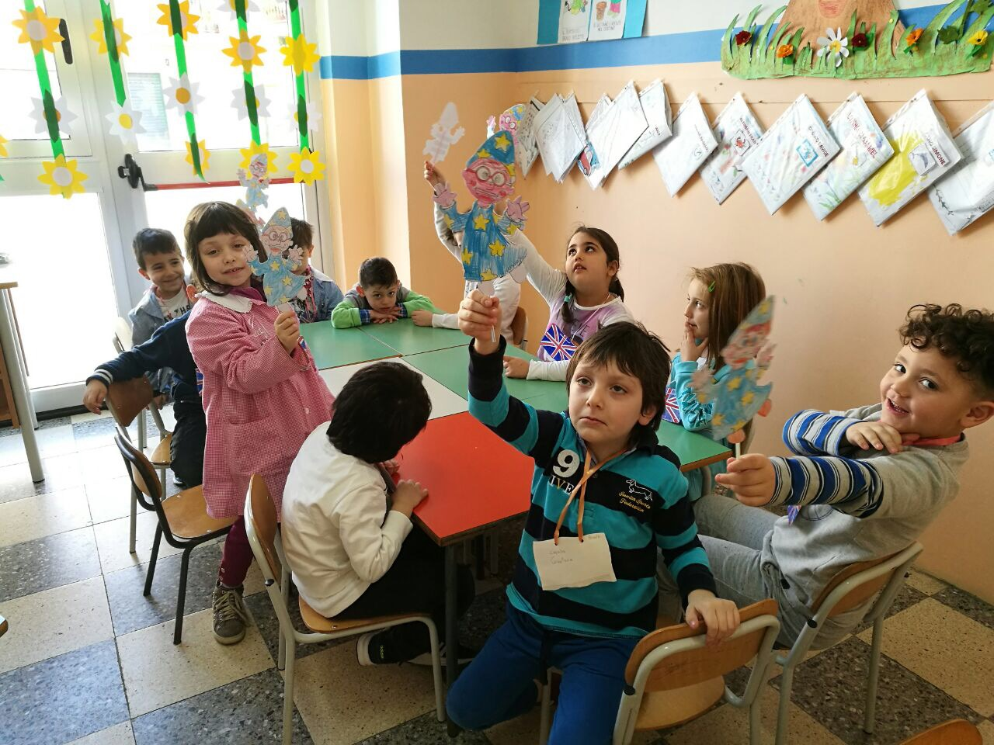
HELLO WIZZY!

Slide 6
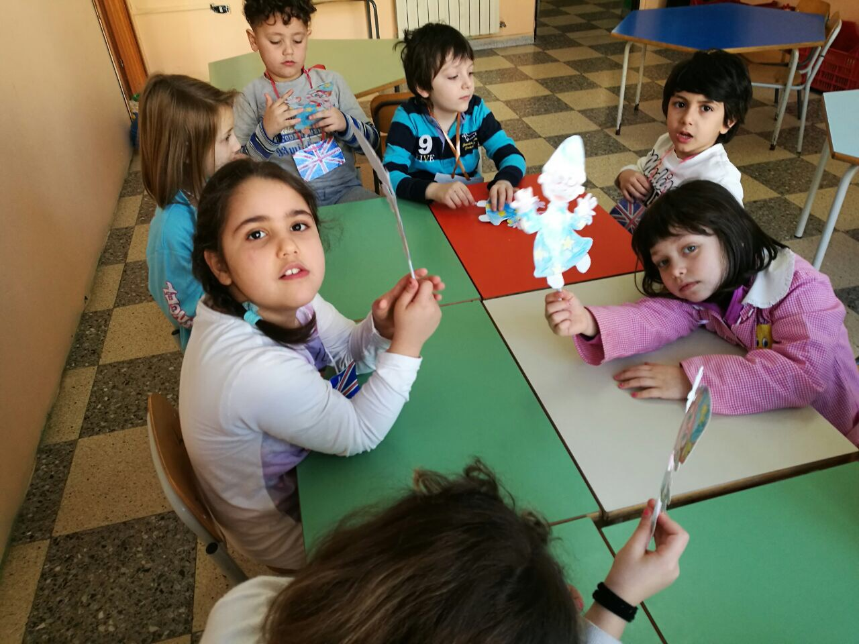
……WE HAVE FUN WITH YOU!

Slide 7
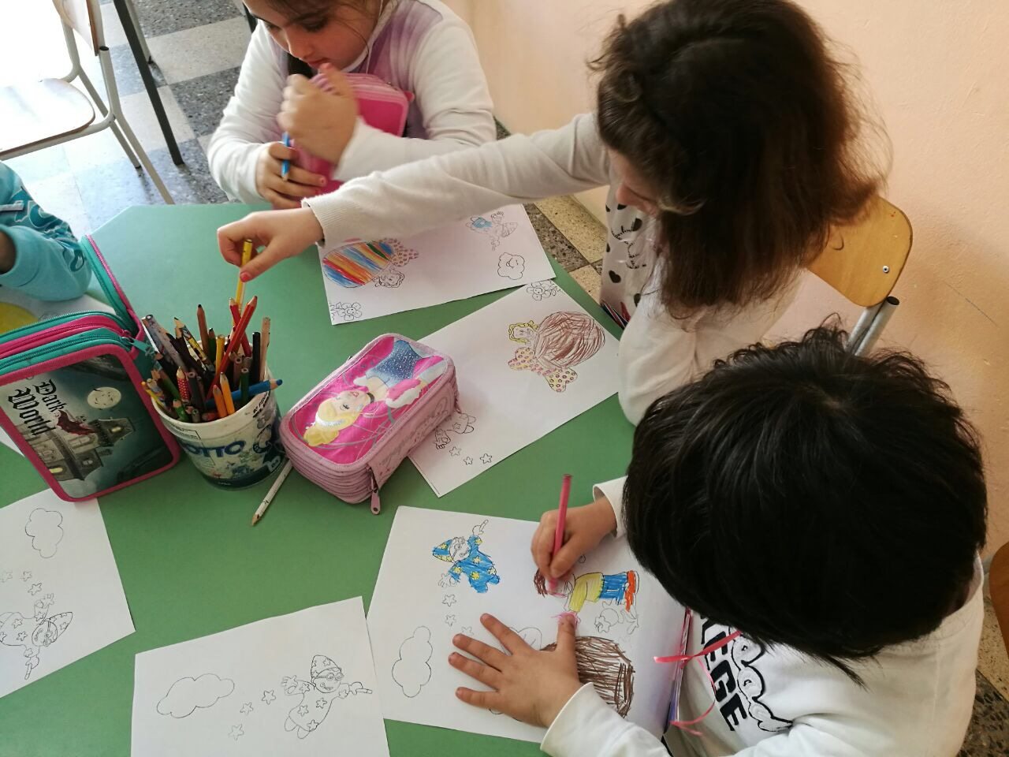

Slide 8
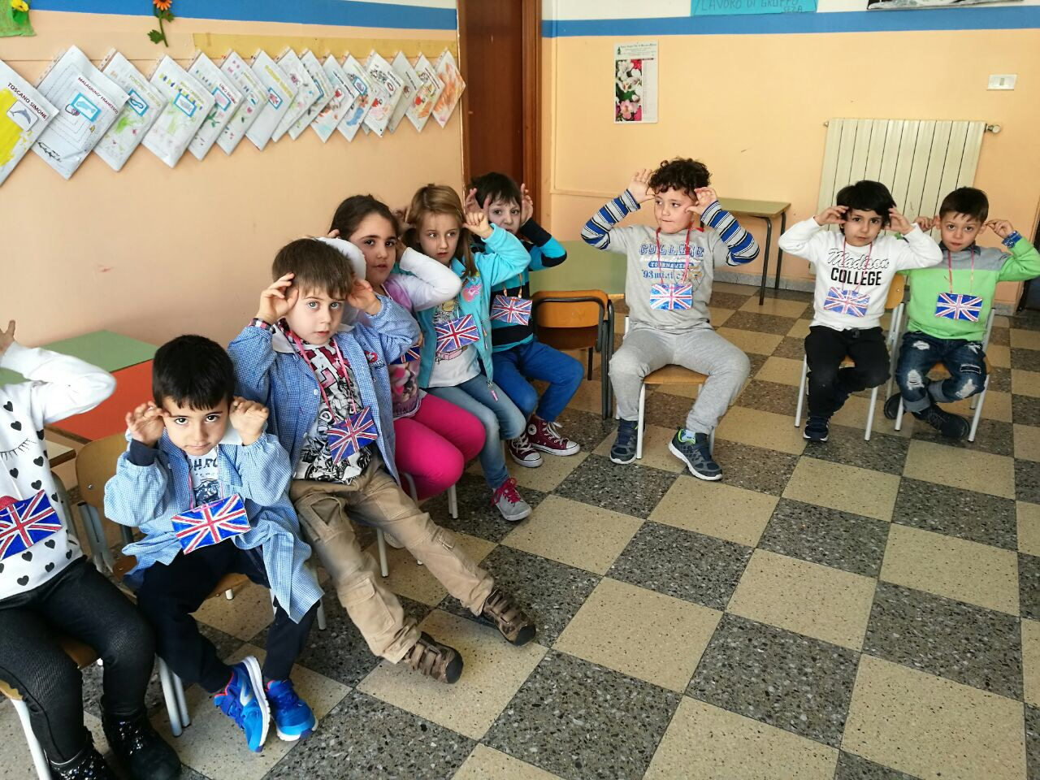
Hop, hop little rabbit!

Slide 9
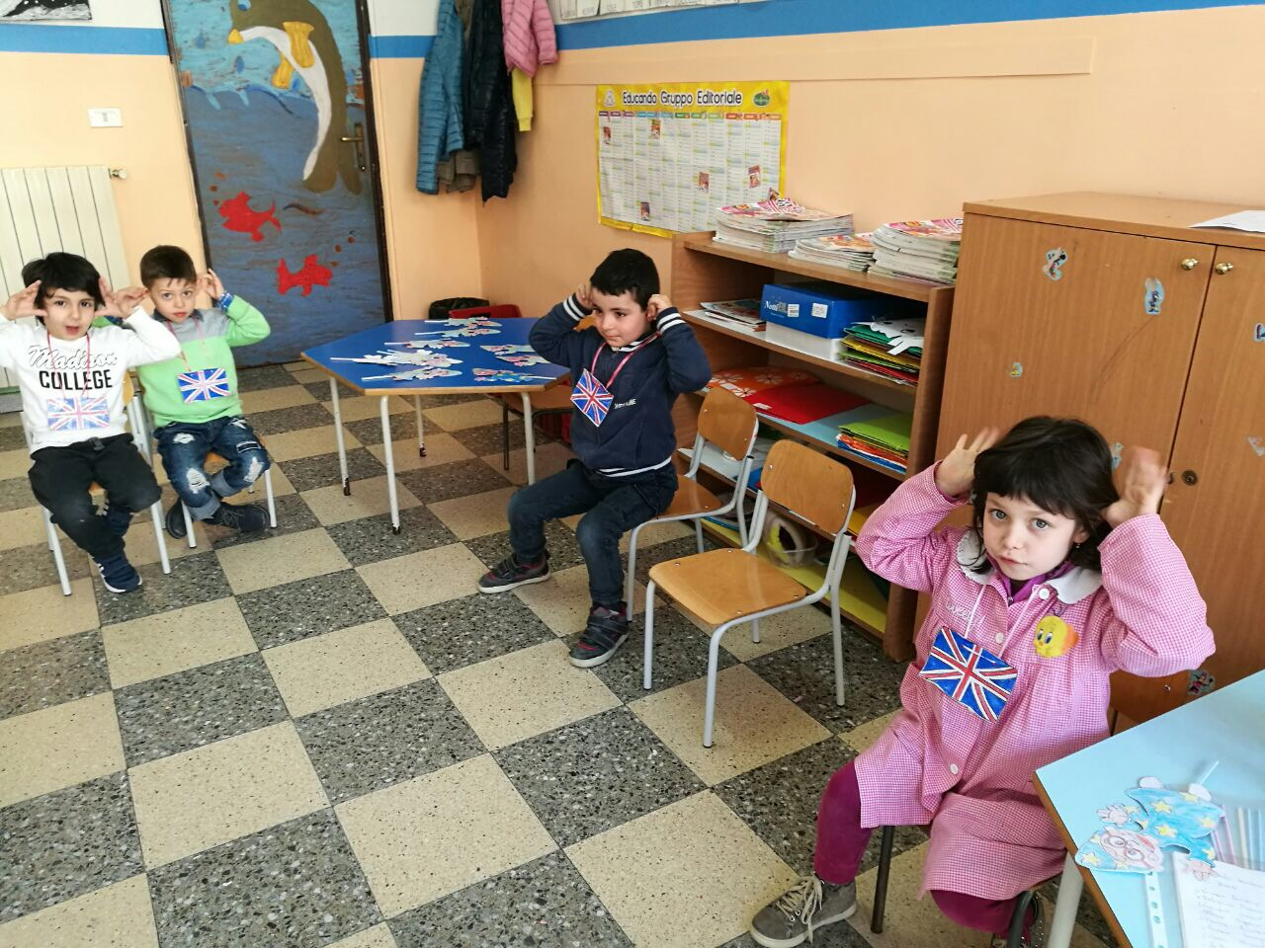

Slide 10
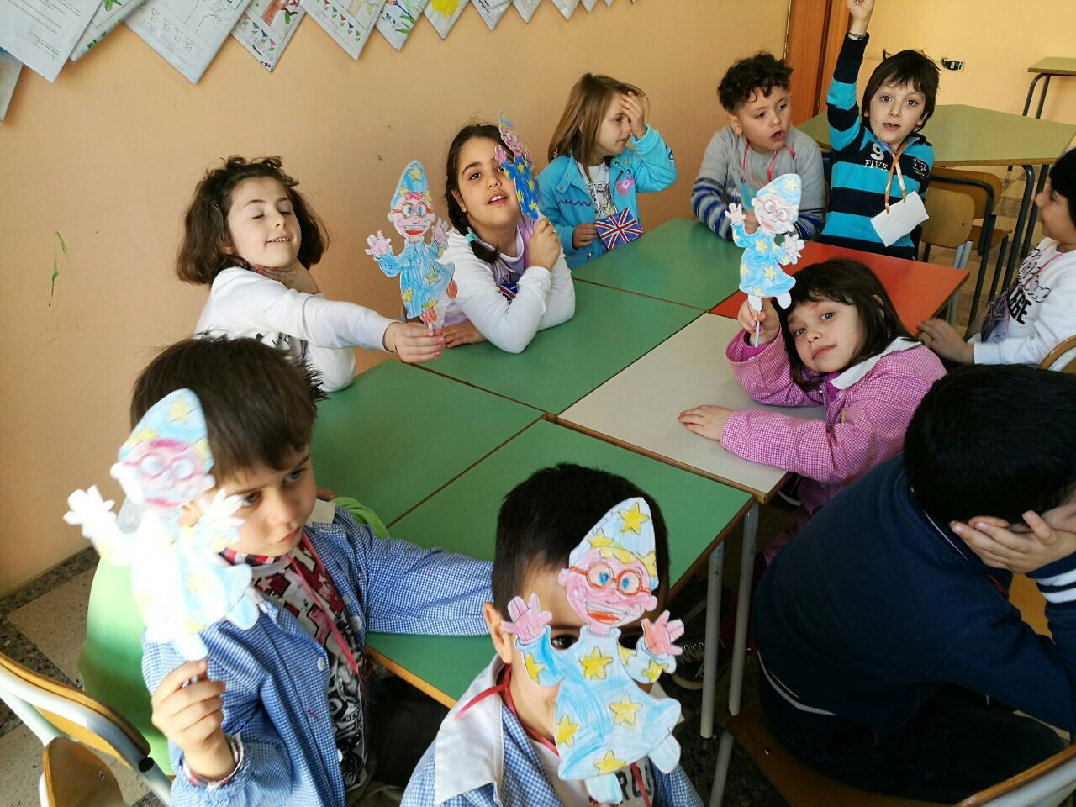
WIZZY, WE LOVE YOU!

Slide 11
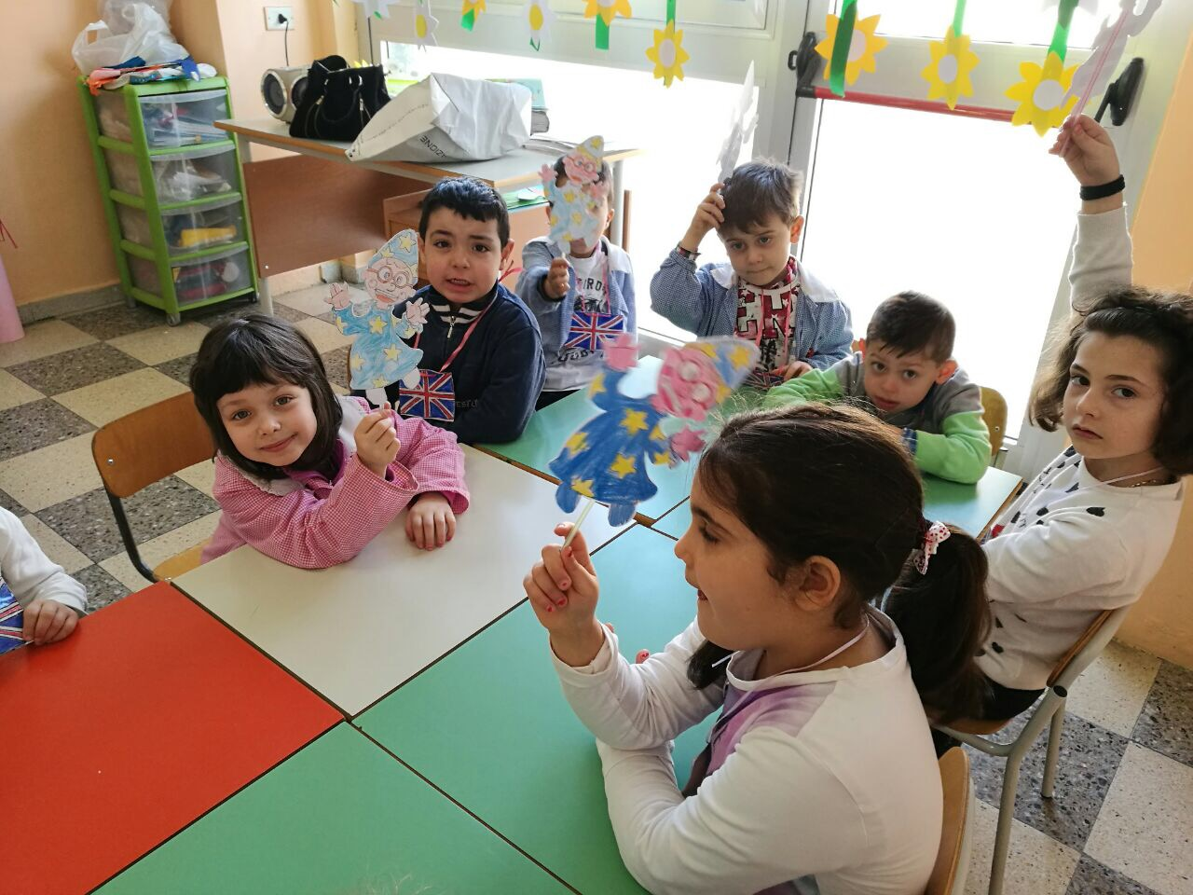

Slide 12
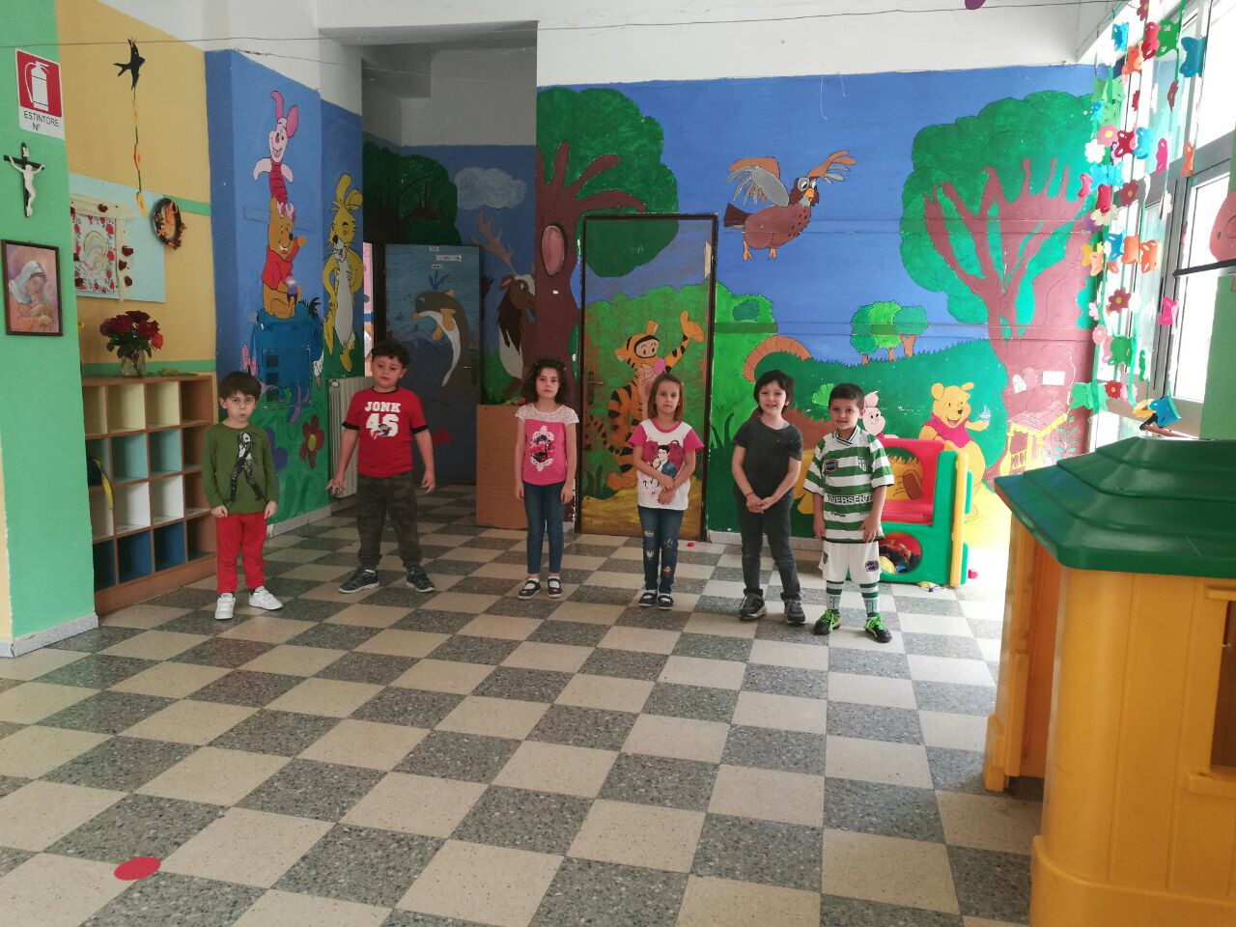
READY , STEADY, ….GO!!!!

Slide 13
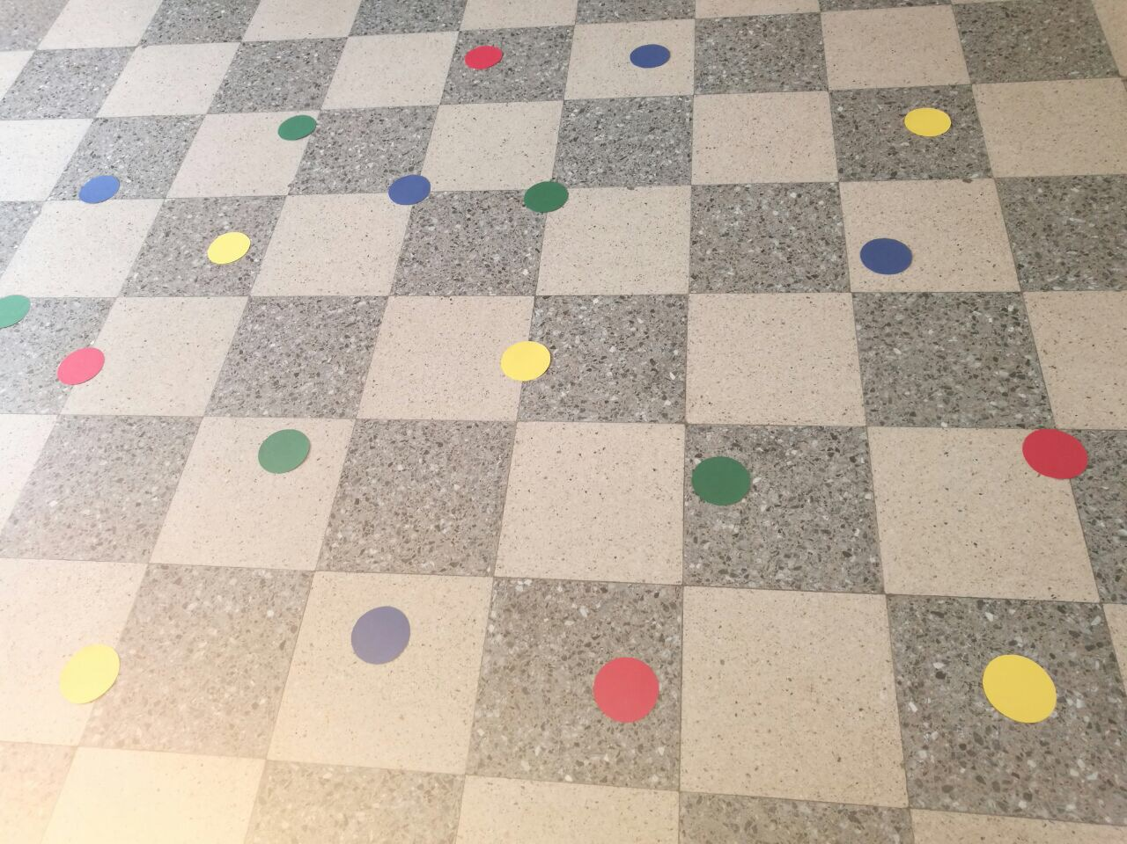
AND NOW….PLAY!

Slide 14
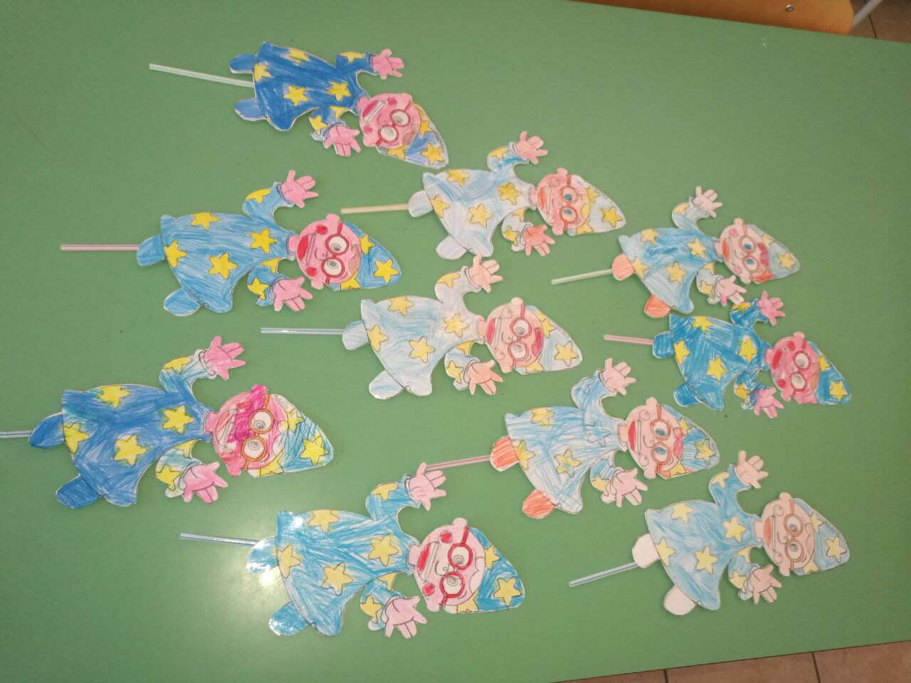

Slide 15
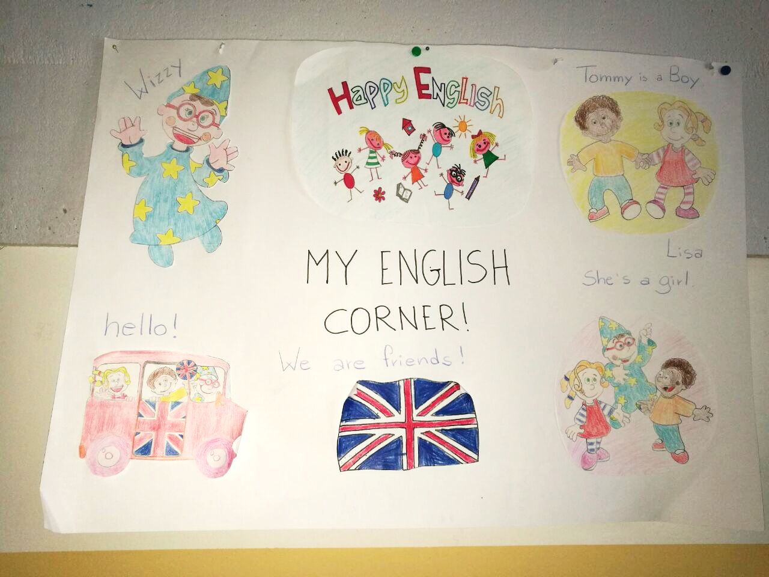

Slide 16
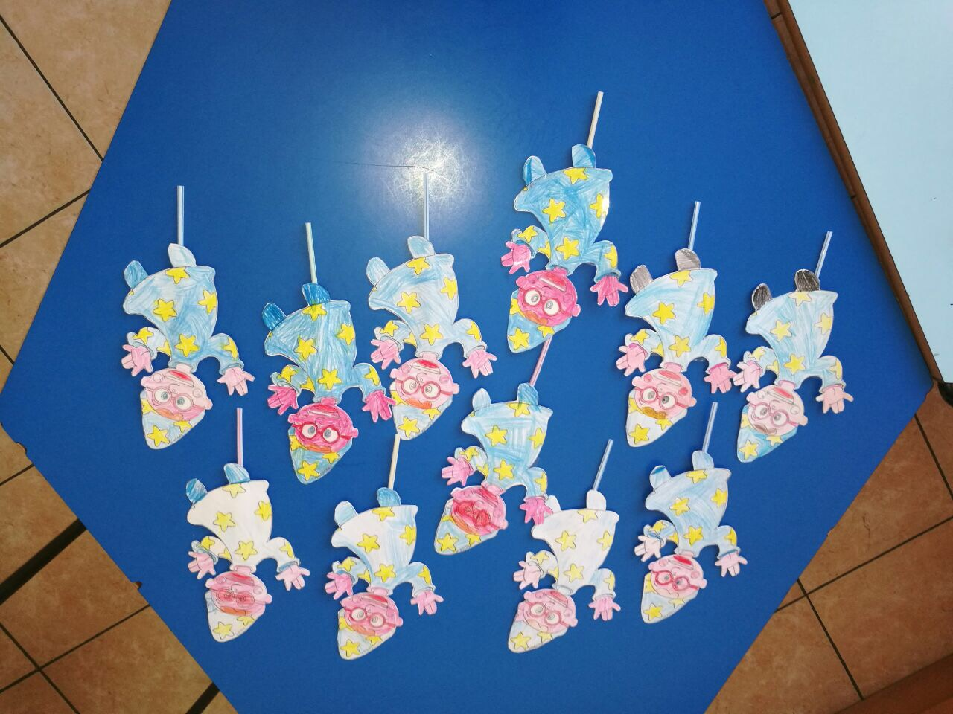

Slide 17
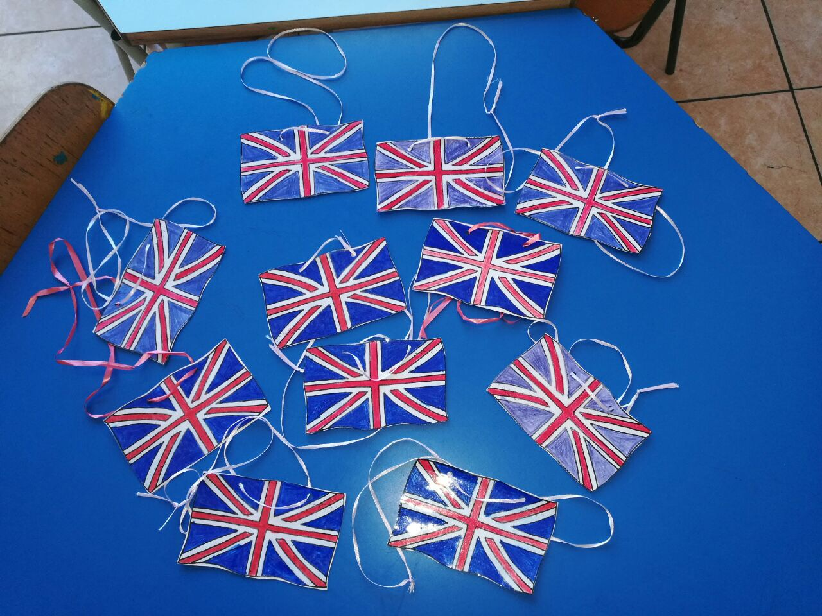
OUR FLAGS

Slide 18
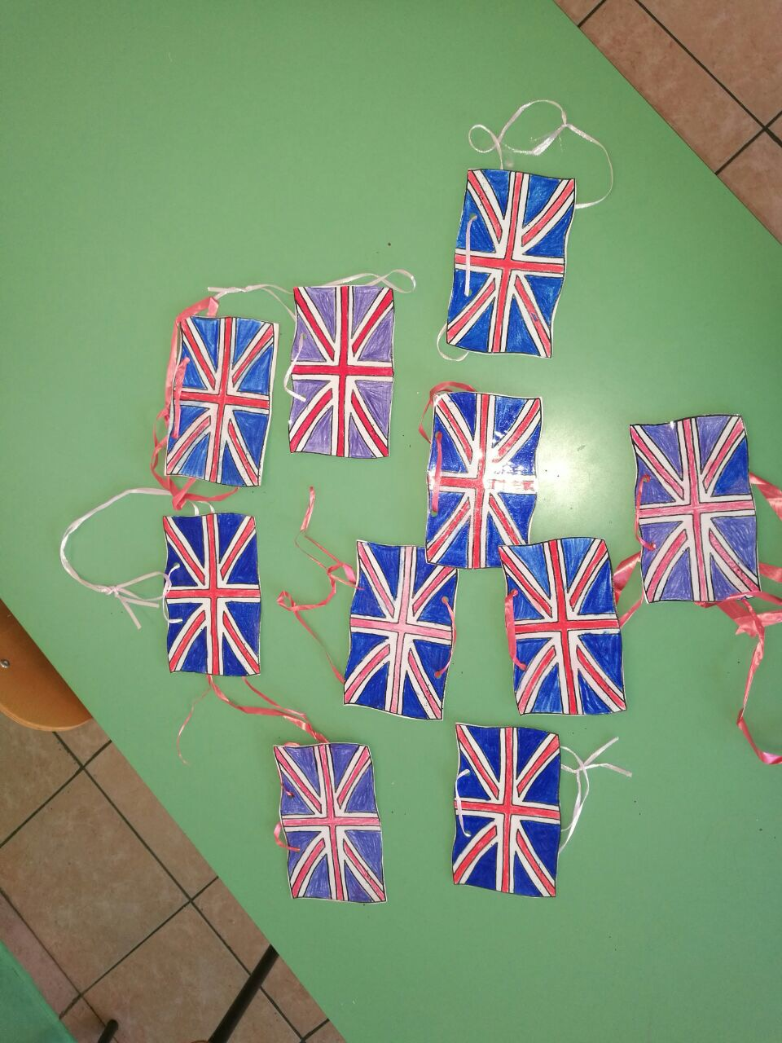

Slide 19
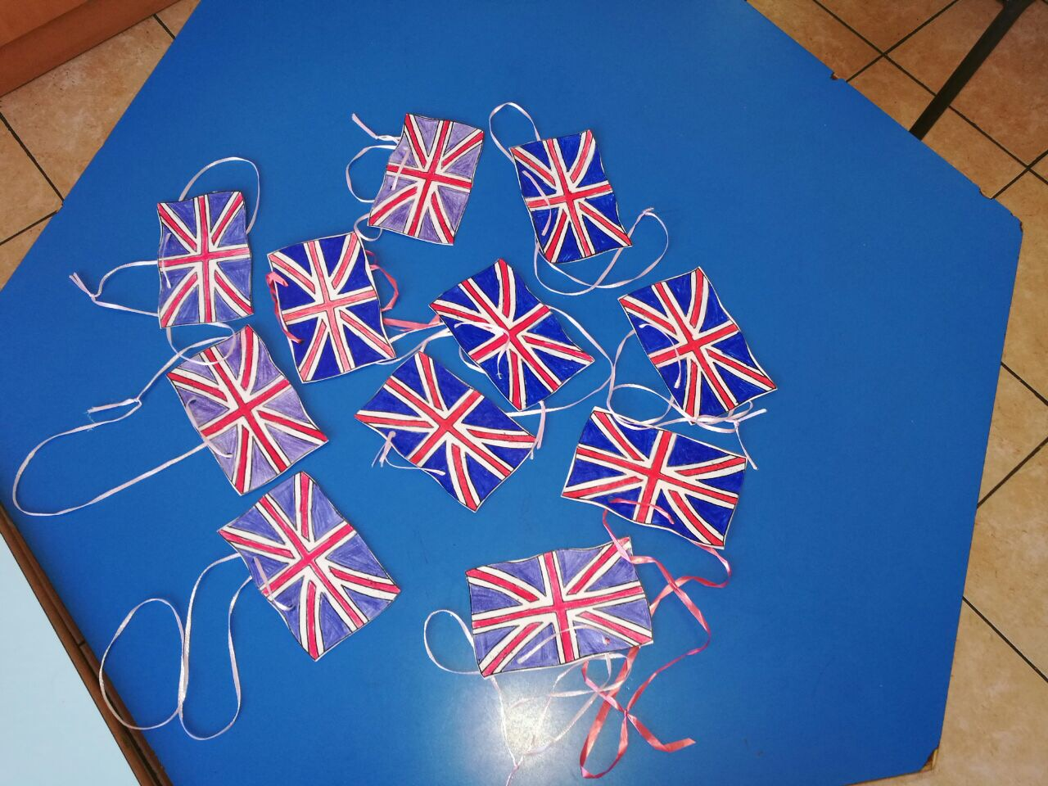

Slide 20
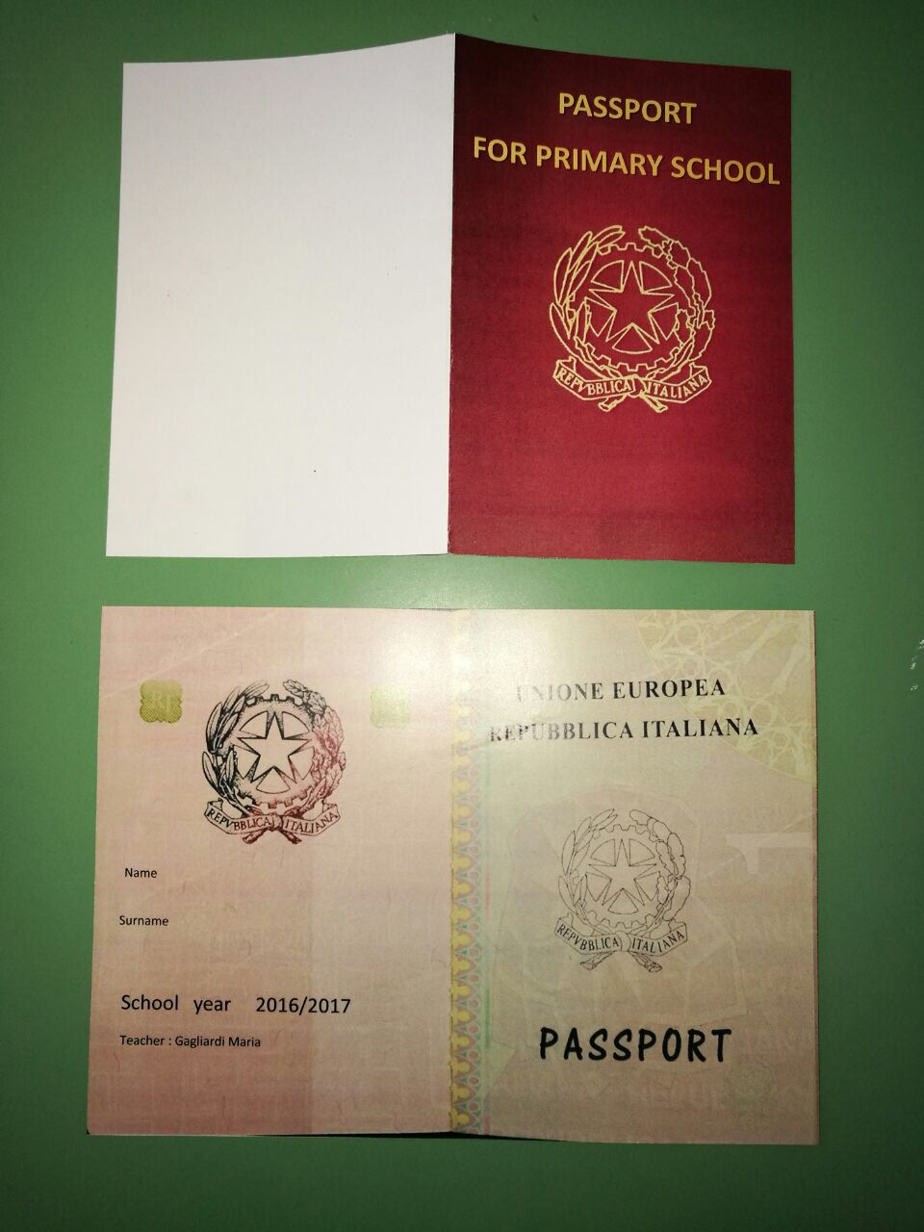
MY FIRST PASSPORT

Slide 21
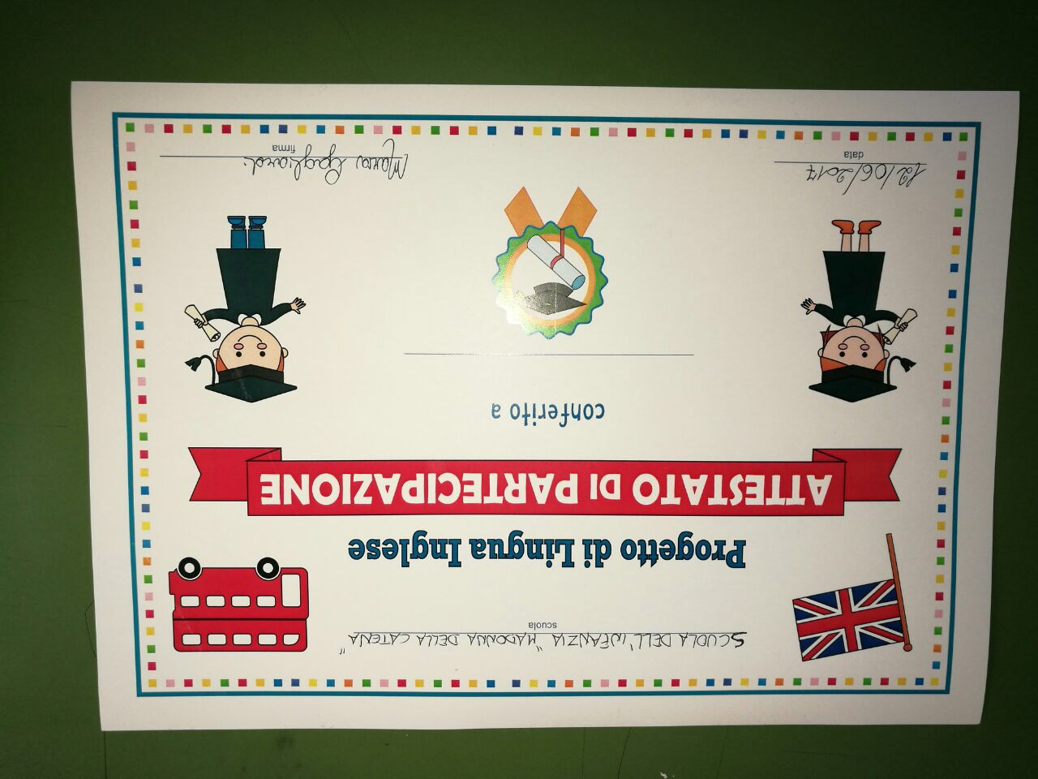
AND NOW….I’M READY TO GO

Slide 22
BYE , BYE WIZZY!
BYE, BYE LITTLE WIZARD!
BYE TOMMY!
BYE LISA!
SEE YOU SOON!

